Slide 1


.
`
MONTHLY FINANCIAL REPORT
through February 28, 2021 (FY 2020-21)
March 12, 2021

Slide 2
Current Full-Year Forecast
for Fiscal 2020-2021

Slide 3


Slide 4
Key assumptions to the January forecast:
In-person hybrid model instruction for all students starting April 5.
We only receive half of the Magnet School Transportation Grant; State is about to issue additional guidance on the issue.
We annualized the March 5 payroll for the remainder of the year.
Revenue estimates are still somewhat conservative.

Slide 6
Although the overall projection changed by only $31,000, several changes impacted the forecast:
Higher than expected overtime in January and February, which reflects additional work to ready schools and snow removal around the buildings.
A significantly higher reimbursement rate for the Special Education Excess Cost Grant than was originally estimated.
Legal settlements on track for roughly $200,000 for the full year, versus a budget of $450,000.
Continued lower utility expenses, especially electricity.
With four months to go in the fiscal year, we remain conservative in our estimates.

Slide 7
February Fiscal Results

Slide 8
Total expenditures through 2/28/21 are $131.6 million.
General Fund expenditures incurred through 2/28/21 are $96.9 million or 51.2% of the adopted budget.
Grant expenditures incurred through 2/28/21 are $34.7 million or 38.9% of the expected grant revenue.

Slide 9
Fiscal Year 2020-2021
Expenditures (Unaudited) as of February 28, 2021

Slide 10
General Fund Details

Slide 12
Notes:
Transportation and tuition expenditures do not reflect funds received from grants (Special Ed Excess Cost, Magnet School Transportation) or other revenues (tuition received from other districts sending students to New Haven). These will lower the gross expenditures once the funds are received.
Actual transportation expenses are still understated.

Slide 16
Special Funds (Grant) Details

Slide 17
FY2020-2021
Grant Sources (Revenues)
See explanatory notes next page

Slide 18
How to read the new grant revenue exhibit (letters refer to column letters on the prior page):
A The total amount we were awarded for the grant in 2019-20
B Because of Covid-19, we are permitted to unexpended money in some grants in 2020-21. It ‘carries over’ to the next fiscal year.
C This is new funding we were awarded in 2020-21.
D Funding we haven’t received yet, but will.
E C+D. The total new money we’ll receive for the grant this year.
F B+E. The sum of the carryover funds and the new money. This is what’s available to spend in 2020-21.
G E-A. This measures the change in new money only, and excludes the effect of the carryover.
H G/A. Calculates, on a percentage basis, the change in the new money year over year.

Slide 19
Notes:
$37.8 million in ESSER II funds not included in our current reporting. Will be included once an approved budget is entered into Munis.
$16.5 million drop in new funds largely due to ESSER I and quarterly installments of Federal magnet funds. Adjusting for the above, new money still down about $3 million from the prior year.
However, total funds available to spend are nearly the same.
Closing tracking ESSER III (American Rescue Plan Act of 2021).

Slide 20
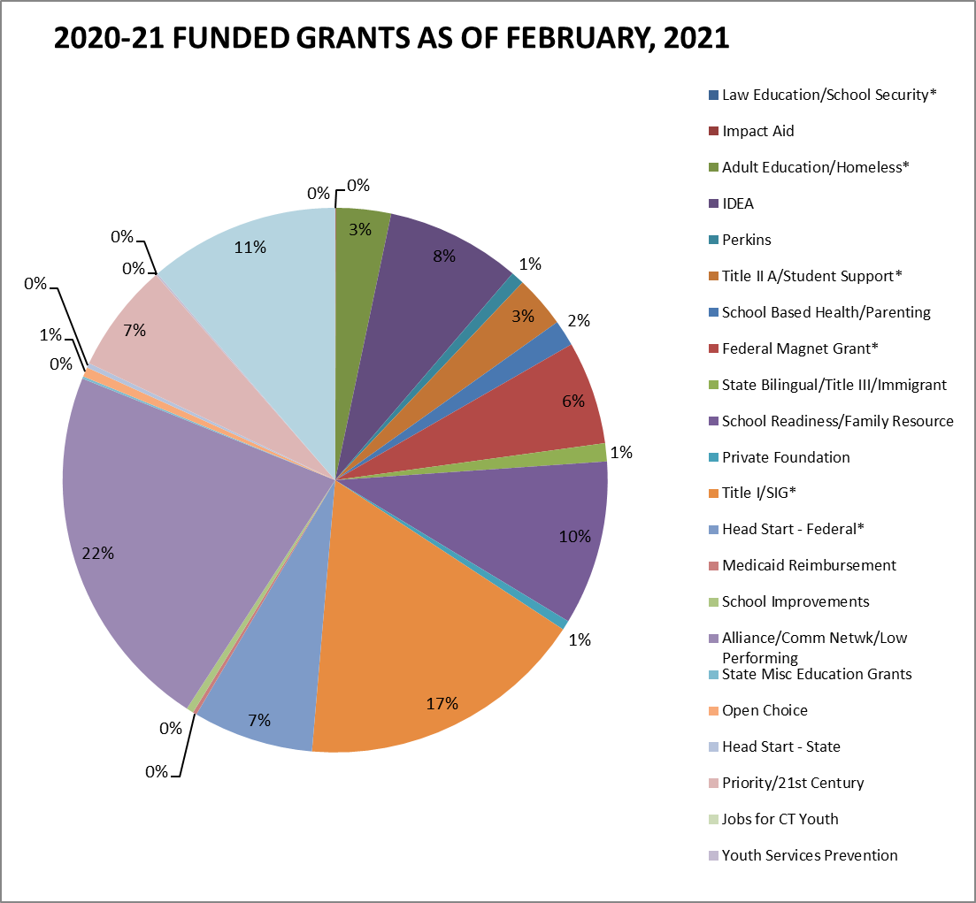

Slide 21
Fiscal Year 2020-21
Grant Funds (Special Funds) Expenditures

Slide 22
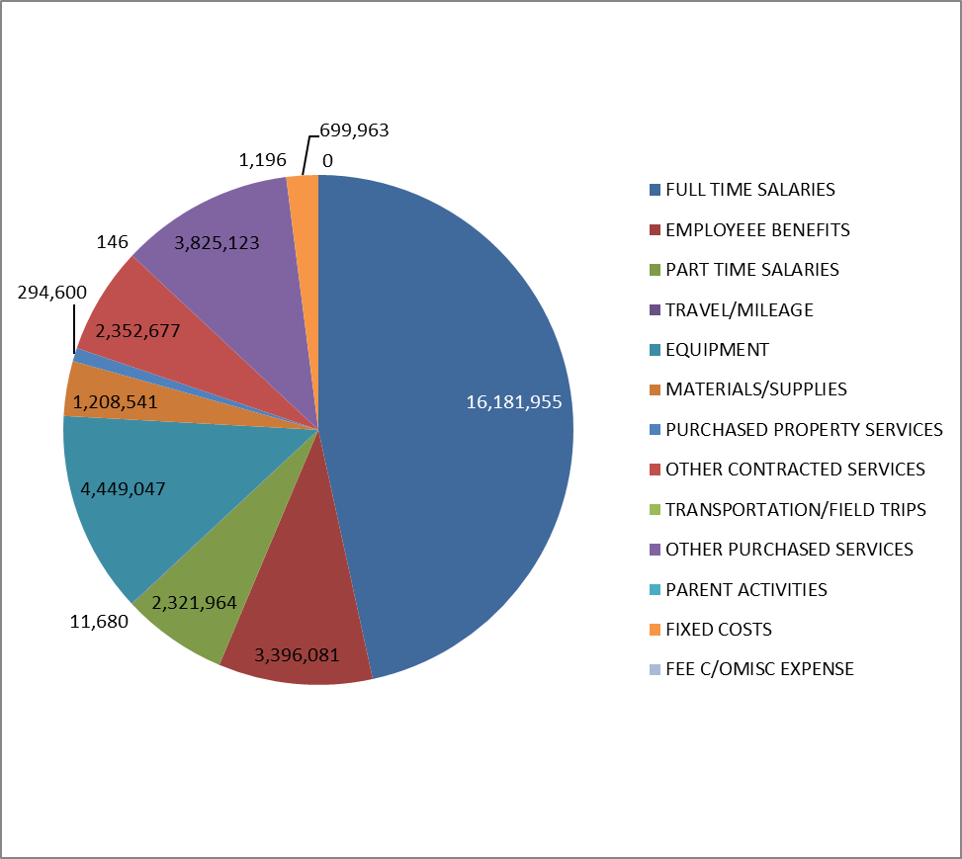
2020-21 GRANT FUNDED EXPENDITURES BY CATEGORY

